Slide 1
Secure Data Hiding in Image Using Steganography
CAPSTONE PROJECT
Presented By: Aniket Kumar
Student Name : Aniket Kumar
College Name & Department : Lovely Professional University, CSE

Slide 2
OUTLINE
Problem Statement
Technology used
Wow factor
End users
Result
Conclusion
Git-hub Link
Future scope

Slide 3
Problem Statement
The problem of secure data hiding in images arises due to the need for confidential communication and data protection in digital environments. Traditional encryption methods make hidden data noticeable, whereas steganography conceals information within images without raising suspicion. The challenge is to develop an efficient steganographic technique that ensures high security, minimal image distortion, and resilience against attacks while maintaining data integrity.

Slide 4
Technology used
Libraries:
OpenCV (cv2) – for image processing
OS (os) – for file handling and system commands
String (string) – for character encoding
Programming Language:
Python
Platform:
Windows (uses os.system("start encryptedImage.jpg") to open the image)
Development & Version Control:
Python IDLE – for writing and executing the script
GitHub – for version control and project repository management

Slide 5
Wow factors
Dual-Layer Security – Combines steganography with a password-based authentication system, ensuring only authorized users can retrieve the hidden message.
Minimal Image Distortion – Embeds data in pixel values while preserving the overall visual integrity of the image, making detection extremely difficult.
Lightweight & Fast Execution – Uses direct pixel manipulation for efficient encoding and decoding without requiring complex algorithms or heavy computational power.
No External Dependencies Required – Runs seamlessly on Python with built-in libraries and OpenCV, making it easy to implement and deploy.
Cross-Platform Compatibility – Although designed for Windows, the logic can be adapted for Linux/macOS with minimal modifications.

Slide 6
End users
Cybersecurity Enthusiasts – Individuals exploring data protection techniques and secure communication methods.
Journalists & Whistleblowers – Professionals who need to secretly share sensitive information without attracting attention.
Intelligence & Defence Personnel – Government agencies and security forces requiring covert data transmission.
Ethical Hackers & Researchers – Experts studying steganography and cryptography for security advancements.
Corporate & Legal Professionals – Businesses and law firms protecting confidential data from unauthorized access.

Slide 7
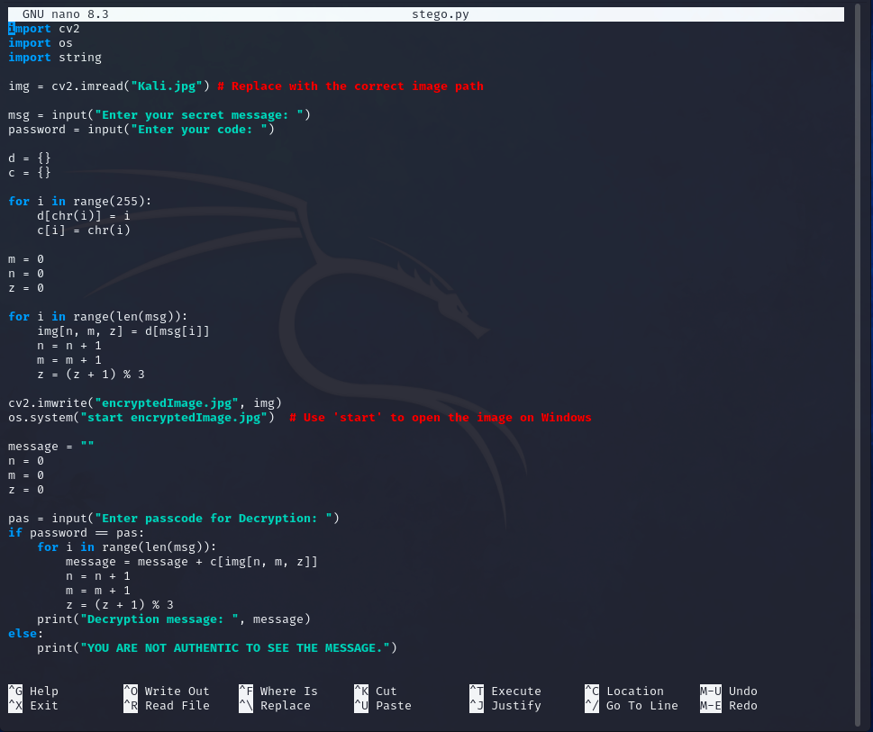
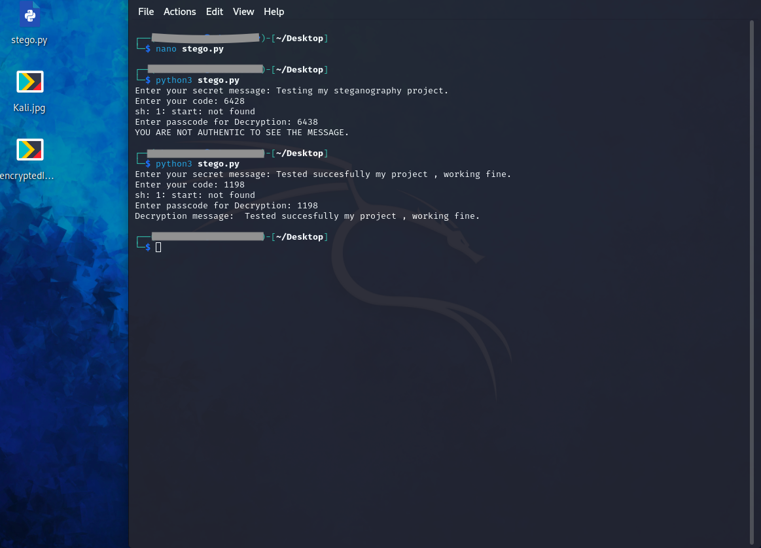
Results
Code:
Execution of code:

Slide 8

Input Image file:
Output Image file:

Slide 9
Conclusion
Implements secure data hiding using steganography, ensuring confidential messages remain undetectable within an image.
Strengthens security by integrating password-based access, preventing unauthorized decryption.
Preserves image integrity by minimizing distortion and maintaining the original appearance.
Optimizes performance for a lightweight, efficient, and cross-platform experience, enabling accessibility for researchers, security professionals, and privacy-conscious users.
Expands future potential by incorporating advanced encryption, enhancing error handling, and developing a GUI-based interface for a more user-friendly and robust application.

Slide 10
GitHub Link
GitHub Link: https://github.com/ianiketkumar7/Steganography_Project_AICTE.git

Slide 11
Future scope(optional)
Integrating Advanced Encryption – Strengthen security by combining steganography with encryption algorithms like AES or RSA to make data extraction even more secure.
Developing a GUI-Based Interface – Enhance user experience by creating an intuitive graphical interface, allowing non-technical users to easily hide and extract messages.
Implementing AI-Based Detection Resistance – Utilize AI techniques to improve resistance against steganalysis, making hidden data even harder to detect.
Expanding Format Compatibility – Extend support beyond images to other media formats like audio, video, and PDF for broader applications.
Improving Error Handling & Efficiency – Optimize encoding/decoding processes to handle larger data sizes efficiently and enhance system robustness against errors.

Slide 12
SECURE THE DATA TO PREVENT HACKERS THANK YOU

